Slide 1
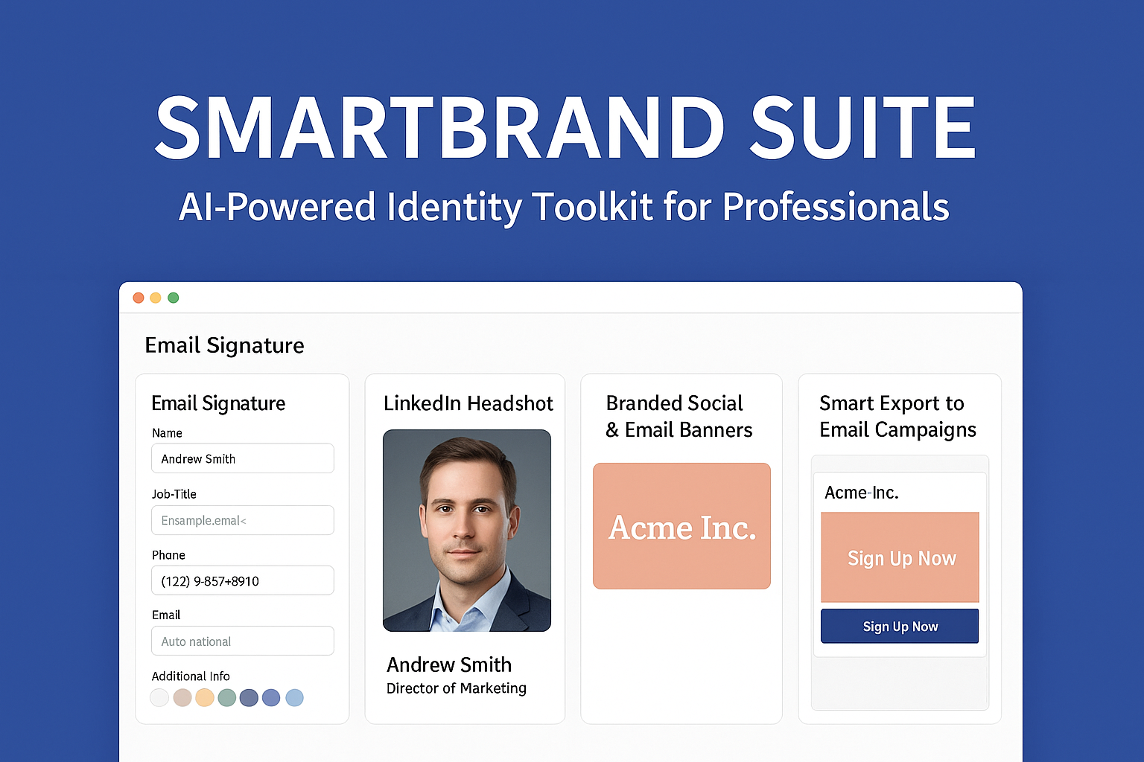
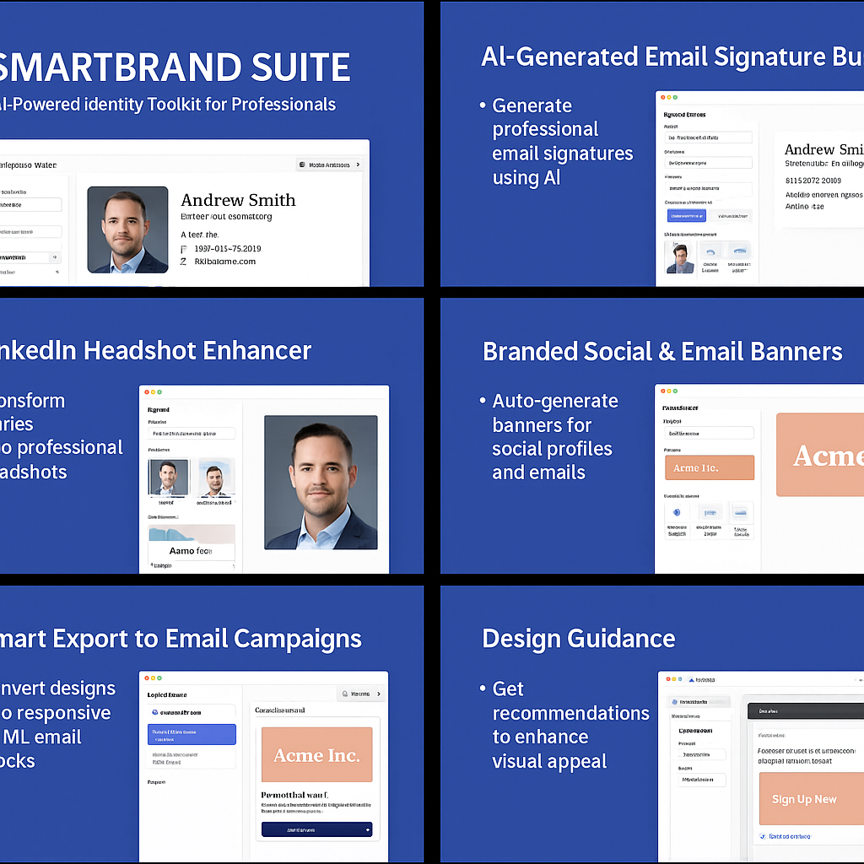
Idea Title: “AI Identity Toolkit for Professionals”
Concept Overview:
A comprehensive add-on for Adobe Express that allows professionals and entrepreneurs to instantly generate polished brand assets — including email signatures, LinkedIn banners, profile headshots, and email-ready design exports — all styled consistently to reflect their personal or company brand.

Slide 2
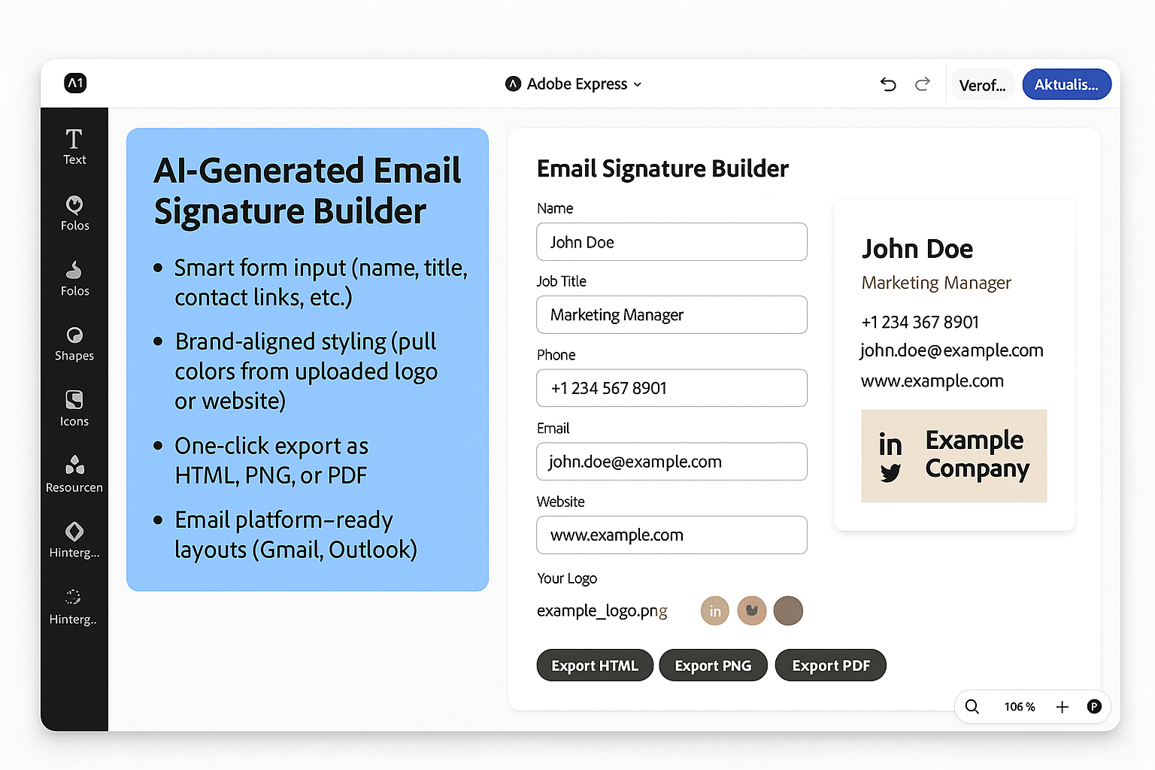
AI-Generated Email Signature Builder
Smart form input (name, title, contact links, etc.)
Brand-aligned styling (pull colors from uploaded logo or website)
One-click export as HTML, PNG, or PDF
Email platform–ready layouts (Gmail, Outlook)

Slide 3
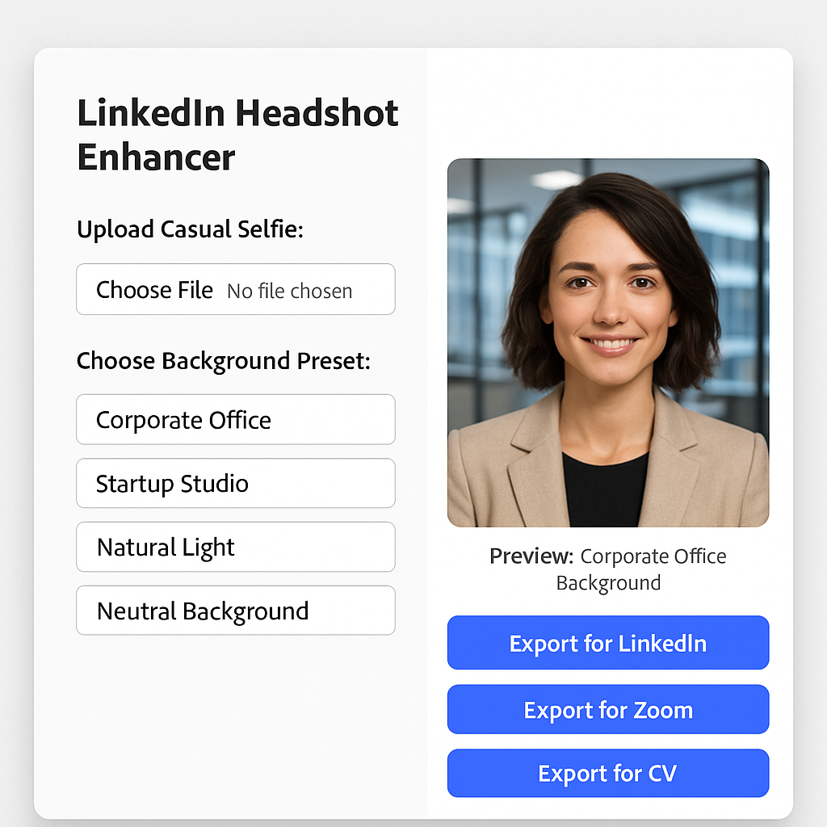
LinkedIn Headshot Enhancer
Upload a casual selfie → AI removes background, enhances lighting, adds professional backdrops
Choose from presets like: “Corporate Office,” “Startup Studio,” “Natural Light,” “Neutral Background”
Export optimized for LinkedIn, Zoom, CVs

Slide 4
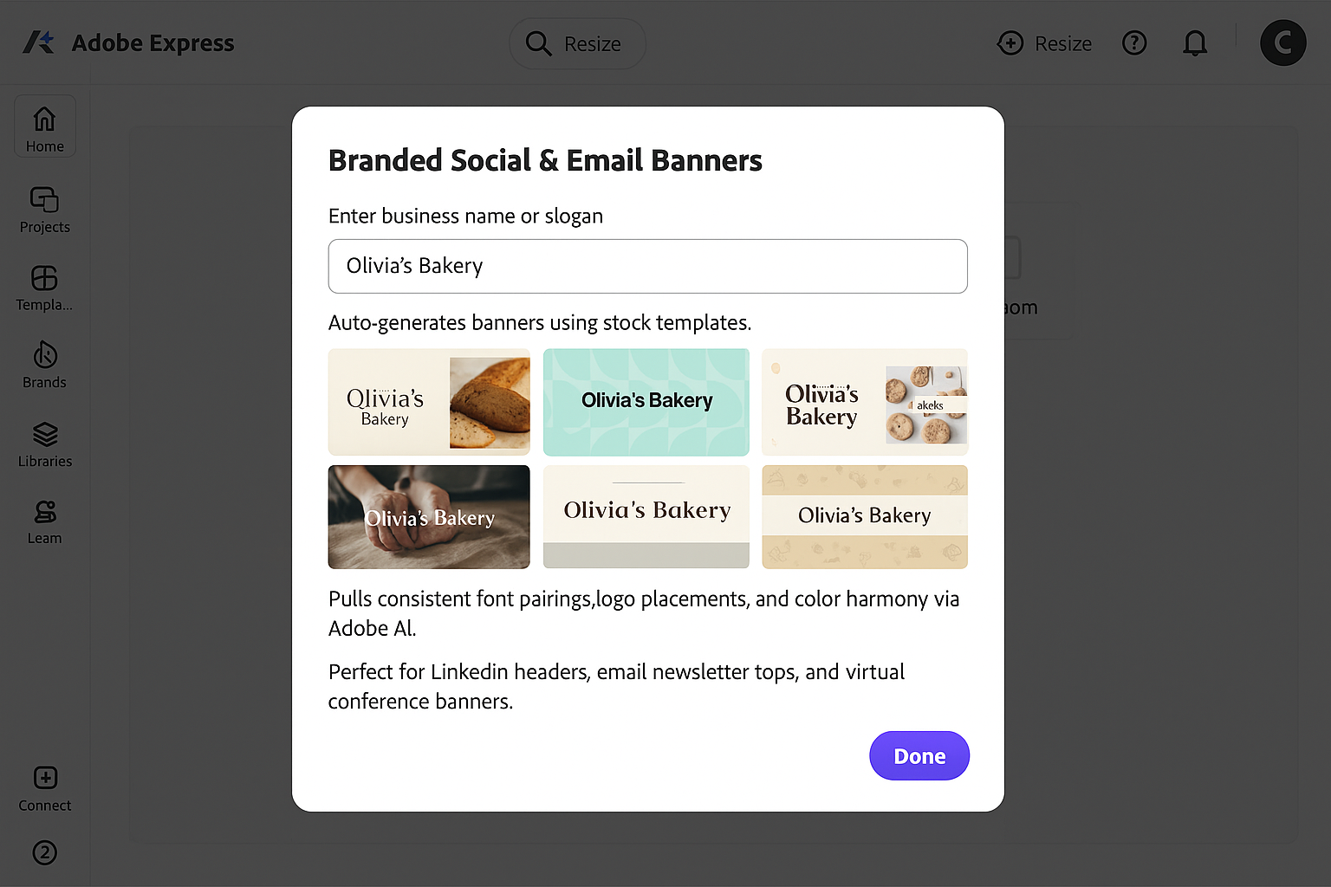
Branded Social & Email Banners
Enter your business name or slogan → auto-generates banners using stock templates
Pulls consistent font pairings, logo placements, and color harmony via Adobe AI
Perfect for LinkedIn headers, email newsletter tops, and virtual conference banners

Slide 5
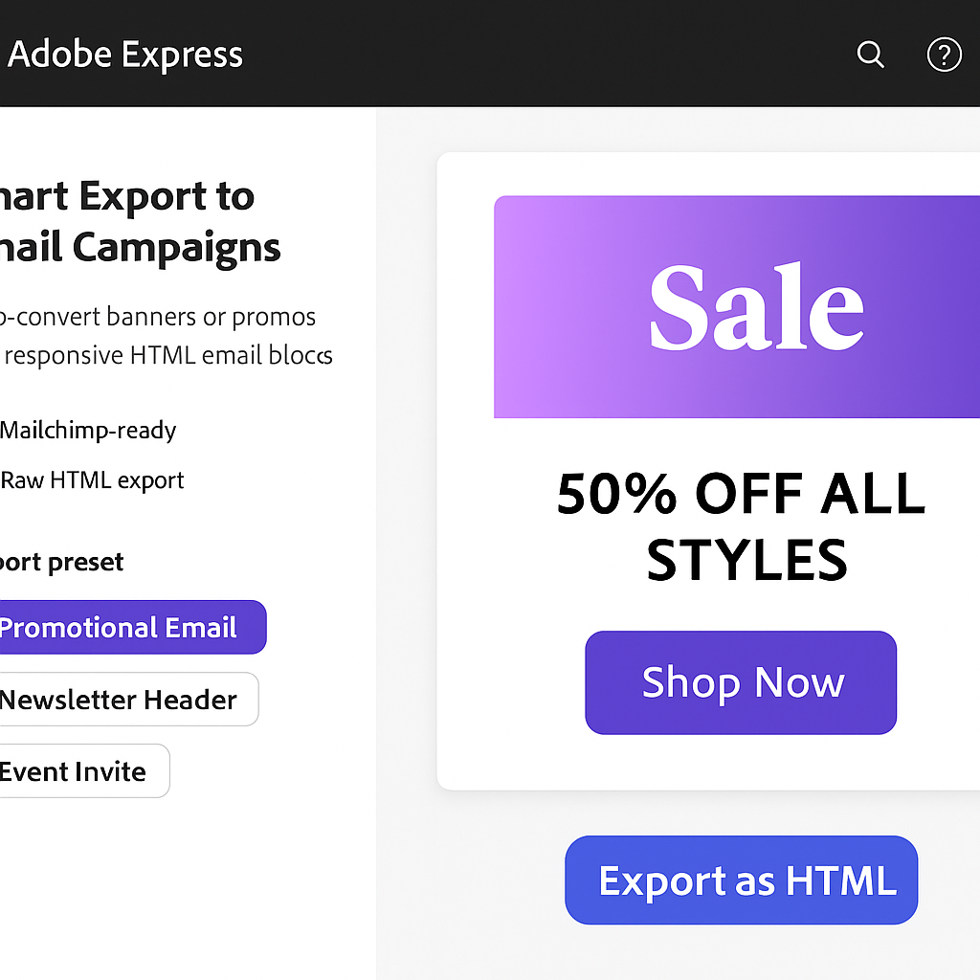
Smart Export to Email Campaigns
Auto-convert banners or promos into responsive HTML email blocks
Mailchimp-ready or raw HTML export
Export preset: “Promotional Email,” “Newsletter Header,” “Event Invite”

Slide 6
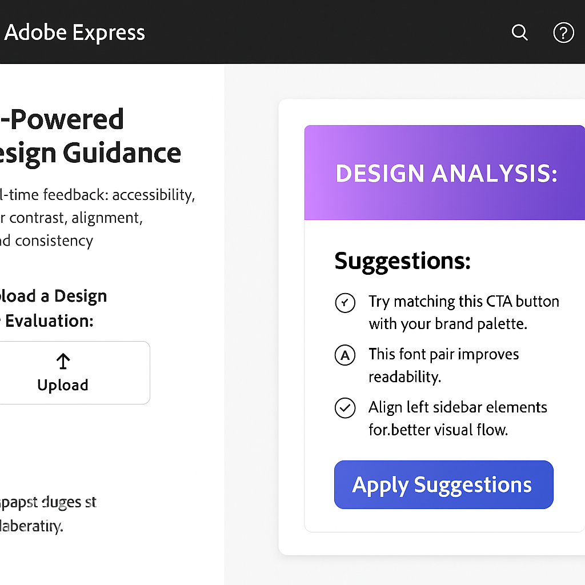
Design Guidance
Real-time feedback: accessibility, color contrast, alignment, brand consistency
Prompt suggestions like: “Try matching this CTA button with your brand palette,” or “This font pair improves readability.”

Slide 7
Impact:
Solves real professional pain points (branding for non-designers)
Leverages multiple Adobe Express APIs: import assets, export HTML, AI design feedback
High adoption potential among marketers, solopreneurs, startup founders, freelancers
Perfectly fits marketing, accessibility, and productivity use cases

